Slide 1
Covid Events Tracker
Areeve Gam (1901846) Vincent Lim (1901833) Benedict Lee (1500210)
Notes:
Line spacing + Page numbers

Slide 2
Agenda
01 Milestone 2 Visualization
02 Task (Why)
03 Idiom (How)
04 Data (What)

Slide 3
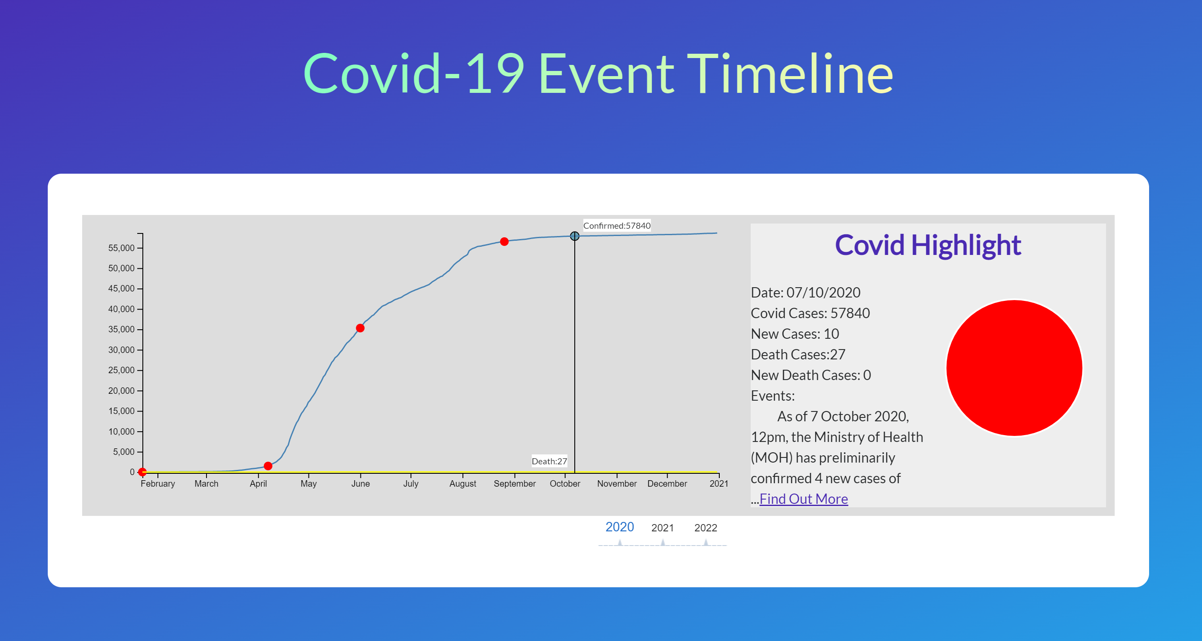
Introduction
01

Slide 4
Task
02
1. Illustrate the number of Infected and Death cases from COVID19 for Jan 2020 to Jul 2022
2. Visualise trends on the increasing number of infected and Death cases as the day progresses

Slide 5
Idiom
03
1. Line graph
2. Pie chart
3. Red dot is used to signify particular event
4. Clickable red dot to retrieve more information

Slide 6
Data
04
Line Graph
1. Qualitative Ordinal X-axis (Dates)
2. Quantitative Ratio Y-axis (Number of confirmed/death cases)
Pie Chart
Quantitative Data (Number of New Cases & New Deaths in a day)
Categorical Data (New Cases & New Deaths)

Slide 7
Allocated Tasks - Areeve
Data Preprocessing
Creation of Event Focus Signifier
Event Focus API call
Year Slider Control

Slide 8
Allocated Tasks - Vincent
Creation of Line Graph
Show side Information for each datapoint
Data Crawling from Site
Creation of Line hover and Tooltip

Slide 9
Allocated Tasks - Ben
Creation of Pie Chart
Tooltip for Pie Chart
UI Design
Data Manipulation for Pie Chart

Slide 10
Demo

